Slide 1
Education and Workforce Development Capacity Planning
Lindsay Koshgarian, UMass Donahue Institute
Carrie Bernstein, UMass Donahue Institute
Marya LaRoche, Education and Training/ Rural Consultant
Western Mass Network to End Homelessness
Family Service Providers Meeting
November 8, 2011

Slide 2
Time for Change
“You work late nights just to keep on the lights”
-- Kanye West, “Hey Mama”
“I know things will get better
You’ll find work and I’ll get promoted
We’ll move out of the shelter…”
-- Tracy Chapman, “Fast Car”

Slide 3
A Challenging Climate
Massachusetts 7.3% unemployment compared to 9.1% nationally
Massachusetts added nearly 38,000 jobs so far this year
Highest unemployment and least recovery among least educated, especially those with high school/ GED or less
Increase in homeless families since 2008
Massachusetts’ right to housing
HomeBASE faces severe funding difficulties and uncertain future
Families continue to be housed in hotels/ motels

Slide 4
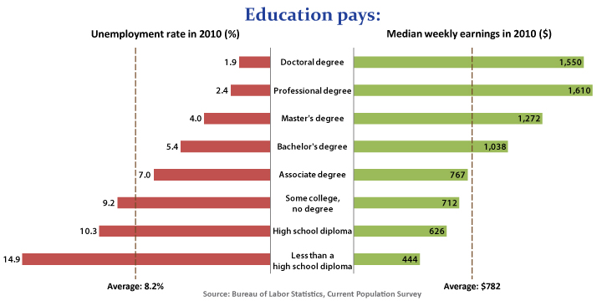
Education pays… if it’s accessible.

Slide 5
Education and Workforce Planning Grant
Focus on family homelessness and families at risk
Family housing sustainability through workforce development
Involve non-traditional partners to address barriers to employment

Slide 6
Outreach and Research Goals
Identifying challenges and building partnerships
What services already exist?
Where does access to services break down?
How can existing services be linked, streamlined or otherwise made more accessible?
Data analysis and outcomes measurement
Who is being served?
What do we know about their employment histories, barriers and needs?
How can we use data to effectively measure progress and target emerging needs?

Slide 7
Addressing Barriers to Employment, Potential Partners
Housing & Shelter providers
Employers
Career centers
Regional Employment Boards
Community colleges
Child care providers
Health care providers
Mental health and substance abuse providers
Literacy programs
Others…

Slide 8
Questions for Providers
What services are represented now?
What current/ past partnerships have been successful? Where were there “near misses”?

Slide 9
Planning Team Tasks
Identify recognized best practices and innovative approaches
Explore on-the-ground challenges and opportunities
Participant focus group(s)
Stakeholder focus group(s)/ listening sessions
Key stakeholder interviews
Data analysis
Obtain HMIS/ ETO ASIST from providers and other data
Identify outcome measures and establish baseline if data allow
Develop action plan
Match Western Mass resources/ strengths with best practices and approach for implementation

