Slide 1
PREVENTING & Ending Homelessness:
The Role of Housing Authorities
Geraldine McCafferty
City of Springfield Director of Housing
May 3, 2012

Slide 2
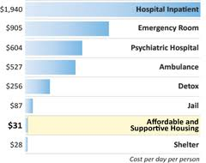
Why “ending homelessness”?
Incredibly expensive
Diverts resources from long-term solutions
Destabilizes communities
Public safety
Moral obligation
Notes:
Individuals: cost-savings well-studied and documented
Families: School transportation costs, long-lasting impacts on children

Slide 3
Housing the primary response to homelessness
Diversion and Rapid Rehousing
Permanent Support Housing
Meet needs that lead to housing instability
Affordability
Supportive Services
Efficient use of public resources
Limits of “first-come, first-served”
Targeting
“Right resource to the right person at the right time”

Slide 4
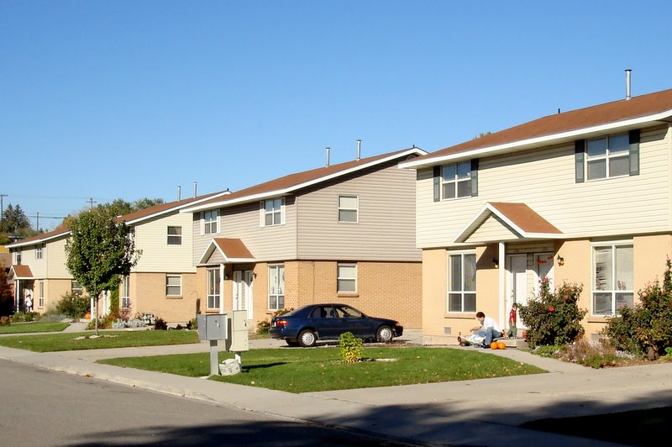
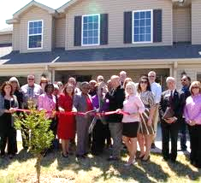
PHAs are critical partners in the effort to prevent and end homelessness
Control significant amount of housing resources
Expertise and knowledge of local housing market.
Effectiveness of a subsidized housing unit in preventing repeat homelessness
Notes:
On the federal level, USICH and HUD repeatedly emphasize the importance of this role.
DHCD here today to emphasize how important this role is to the state.

Slide 5
Barriers to overcome
Tenant Issues
Targeting Issues
No resources for support services
Responsibility to landlords and community at large
Trust and sustainability issues with service-provider partners
Fairness
Potentially meaningless where insufficient supply of housing to meet demand
Response:
Partnerships
Start with pilots
Choose partners with experience & strong track record
Response:
Data-driven
Careful design

Slide 6
Community opposition
Difficulty in siting supportive housing
Can result in projects that do not serve the people most in need of supportive services
Response:
Very small or scattered site
Existing housing units
Mixed housing (some PSH in larger development)

Slide 7
PHA programs in place throughout nation
Project-based section 8 + supportive services
Priorities or set-asides in existing housing
Streamlined lease-up procedures
HA property managed by a service provider
HAs developing units using McKinney & other homeless funds
Grant funding for case management, eviction prevention
Regional collaborations among PHAs
Springfield HA
Asheville (NC) HA
Lancaster County (PA) HA
Malden (MA) HA
Portland (OR) HA
Vancouver (WA) HA
Seattle/King Co. Has
DC HA
Phoenix HA

Slide 8
Springfield Successes
Chronic Homeless Initiative
Marble Street Apartments
City-SHA collaboration
SHA provides 100 project-based vouchers
Dedicated city staff provide case management
Vouchers used in scattered site units throughout city
Failing federally-subsidized housing project
Need for PSH for families
Federal waiver & DHCD financial support
Notes:
City-SHA: SHA Board initially opposed
Marble Street: solving SHA problem

