Slide 1
Alignment of Western MA with Opening Doors
Presented by Matthew D. Simmonds Simtech Solutions Inc. January 21, 2015

Slide 2
Project Overview
The Network issued an RFP with the goal of “developing data integration, analysis and reporting capabilities to advance its mission to prevent and end homelessness in the region that aligns with Opening Doors: A Federal Strategic Plan to Prevent and End Homelessness”
Notes:
This just reminds them of what they set out to purchase through this RFP

Slide 3
Primary Themes
Increase leadership
Collaboration & civic engagement
Increase access to stable and affordable housing
Increase economic security
Improve health and stability
Retool the homeless crisis response system
Notes:
This just reminds them of what they set out to purchase through this RFP

Slide 4
Primary Goals of Opening Doors
Opening Doors is a data-driven plan that relies on evidence-based practices to accomplish 4 goals:
Finish the job of ending chronic homelessness in 5 years
Prevent and end homelessness among veterans in 5 years
Prevent and end homelessness for families, youth and children in 10 years
Set a path to end all homelessness

Slide 5
Community-Level Performance Measures
Length of time homeless
Return to homelessness
Access / coverage (thoroughness in reaching persons who are homeless)
Overall reduction in number of people who experience homelessness
Job and income growth for people who are homeless
Reduction in first time homeless
Other accomplishments related to reducing homelessness
Notes:
Except for the last bullet, all of these can be measured with HMIS (2014 standards). However, to do this across the region, with multiple HMIS implementations, requires data warehousing and integration of data. Although we don’t know exactly how HUD will structure it, clearly, accurate and meaningful reporting will require deduplication of clients across systems. So, what the region will likely have to do for reporting and compliance, we can greatly enhance to meet your local objectives. Current, and future, HUD reporting will be seamless and more importantly the data will be used to meet your goals.
By implementing our cutting-edge technology and regular reporting, you will also be able count this as an “other accomplishment”

Slide 6
The Role of System Design in Ending Veteran Homelessness in Boston
3 different data management systems
Two Federal partners (HUD and the VA)
Significant privacy and security concerns
12 different homeless service agencies
100 days to implement and test
Notes:
Andrea and Waypoint Consulting have been great at helping you meet requirements. Open it up for comment, then reveal your list

Slide 7
Notes:
Our challenge for Boston was to create a client management system that could be used by more than a dozen providers to house a targeted group of people (veterans). This technology demonstrates how client records are secure while allowing vital collaboration on a specific goal.
A primary goal for your project is that our work will assist the Network in aligning its work in support of Leadership Collaboration and Civic Engagement.

Slide 8
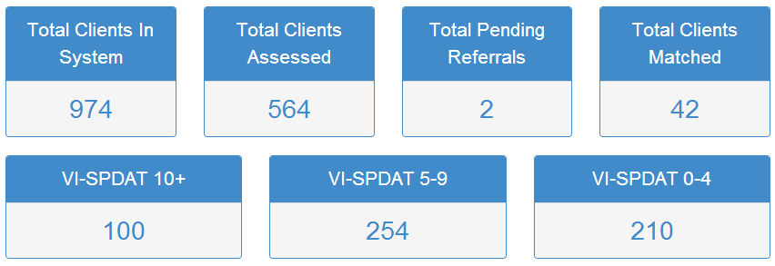
The Results as of 1/21/15

Slide 9
Current Local Challenges?
Large geographic area
2 CoCs
Projects with multiple funding sources
Multiple providers serving the same people without coordination
Changing Federal reporting requirements
Privacy & confidentiality
Resources to provide basic needs including shelter
Ongoing use of paper, rather than HMIS etc. for case management
Limited housing resources
Lack of control of how families are placed in local hotels
Notes:
Andrea and Waypoint Consulting have been great at helping you meet requirements. Open it up for comment, then reveal your list

Slide 10
Q&A

