Slide 1
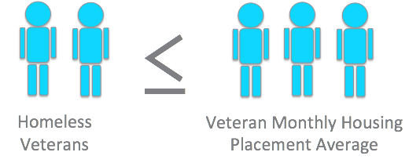
What Do We Mean by Zero?
Functional zero is reached when, at any point in time, the number of people (veterans or chronic) experiencing sheltered and unsheltered homelessness will be no greater than the current monthly housing placement rate for that population (veterans or chronic).

Slide 4
Zero: 2016 Theory of Change
Improve Housing Placement Performance
Increase capability of local leaders
All communities in Zero: 2016 will end veterans homelessness (by 12/31/15) and will end chronic homelessness for individuals (by 12/31/16).
Build a creative, connected and committed movement
Optimally functioning Zero: 2016 Team

Slide 5
Your Community Theory of Change

Slide 6
Western Mass Theory of Change
AIM: We will end veteran homelessness by Jan. 27, 2016
Primary Driver:
Primary Driver
Primary Driver
Primary Driver

