Slide 1
Western Massachusetts Network to End Homelessness
Presentation to Acting Assistant Secretary Mark Greenberg
July 29, 2015

Slide 2
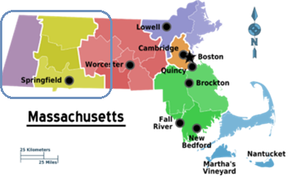
The Western MA Network
What: The Network creates collaborative solutions to end homelessness through a housing first approach that prioritizes prevention, rapid re-housing and housing stabilization
Where: Serves all four Western counties, from Springfield to Pittsfield and dozens of rural communities in between
Who: Over 200 participating partners, including:
Senate President Stan Rosenberg and other Western MA legislators
7 Western MA mayors and town managers
Faith leaders
Bank and other business leaders
Community college presidents and staff
Regional employment boards and career centers
Housing, child care, and health care providers

Slide 3
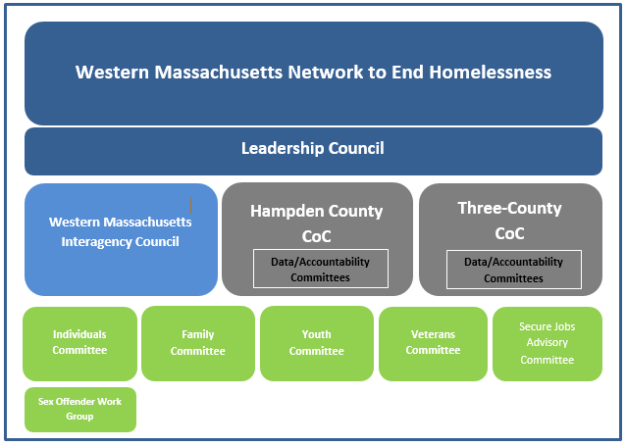
Successes
The development of a robust Western MA Network
July, 2015: Release of the Western MA Opening Doors Plan to End Homelessness, the data-driven framework for preventing and ending all types of homelessness in the region
The Secure Jobs Program, providing employment and housing stability for over 200 families

Slide 4
Ending Family Homelessness
Where we are: The number of families experiencing homelessness in the region has been rising
Where we need to go: HUD Performance Measures such as Reducing the Length of Homelessness
How we get there: Implement resource allocation strategies that focus on outcomes towards making homelessness rare, brief, and non-recurring.
Complete and accurate data will promote a better understanding of barriers and point towards solutions

Slide 5
Lessons Learned & Challenges Ahead
Collaboration and collective impact work are cornerstones to system change
Accessible, quality data is necessary to make change happen
Wraparound case management results in stable housing and employment
The systems of care that a family, or a person in a family, may access do not currently “speak” to each other
Each system of care must adhere to normalized data standards
Continued investment and flexible funds are critical to meeting family barriers, e.g., transportation or child care, as they arise

Slide 6
Recommendations/Action Steps
Provide support, oversight and accountability to ensure that the State’s Emergency Assistance program adheres to Federal data collection and reporting requirements and full compliance with the Homeless Management Information System
Provide mechanisms and support to address privacy concerns when sharing data
Encourage software vendors to adopt a "Service-Oriented Architecture" (SOA) that enables systems to speak with one another. More details on this can be found here or at https://goo.gl/ZbcmHX.
Implement tools and practices to ensure the data being used for performance measures is both complete and accurate
Support coordinated “network” approach to system change across regions

Slide 7
For Further Information
Contact:
Pamela Schwartz, Director
Western Massachusetts Network to End Homelessness
413-219-5658
pschwartz77@gmail.com
http://westernmasshousingfirst.org

