Slide 1
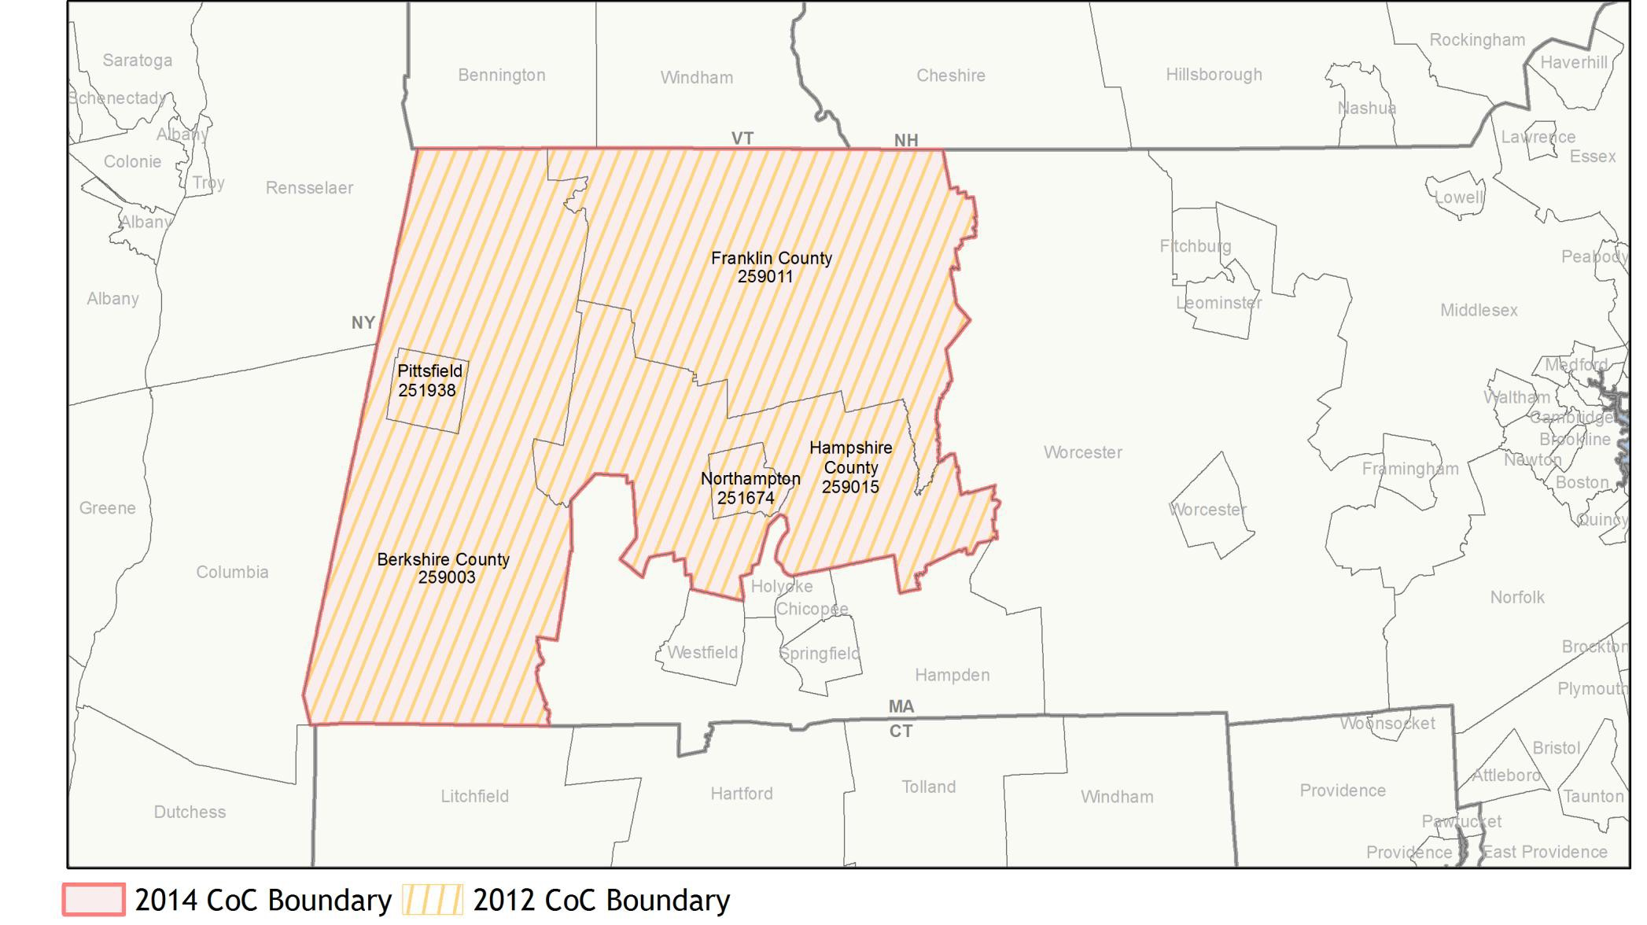
Important Notes About This Data:This report is based on information provided to HUD by Continuums of Care (CoCs) in the fiscal year 2014 application for CoC Homeless Assistance Programs. HUD has conducted a limited data quality review but has not independently verified all of the information submitted by each CoC. The reader is therefore cautioned that since compliance with these standards may vary, the reliability and consistency of the Housing Inventory and Homeless Count data may also vary among CoCs. Additionally, a shift in the methodology a CoC uses to count the homeless may cause a change in homeless counts between reporting periods. For inquiries about data reported by a specific Continuum of Care, please contact that jurisdiction directly. CoC contact information can be found on the HUD Exchange website (https://www.hudexchange.info/grantees/?granteesaction=main.searchresultsprogramid=3).
CoC Name:
Pittsfield/Berkshire, Franklin, Hampshire Counties CoC
CoC Number: MA-507

Slide 2
Important Notes About This Data:This report is based on information provided to HUD by Continuums of Care (CoCs) in the fiscal year 2014 application for CoC Homeless Assistance Programs. HUD has conducted a limited data quality review but has not independently verified all of the information submitted by each CoC. The reader is therefore cautioned that since compliance with these standards may vary, the reliability and consistency of the Housing Inventory and Homeless Count data may also vary among CoCs. Additionally, a shift in the methodology a CoC uses to count the homeless may cause a change in homeless counts between reporting periods. For inquiries about data reported by a specific Continuum of Care, please contact that jurisdiction directly. CoC contact information can be found on the HUD Exchange website (https://www.hudexchange.info/grantees/?granteesaction=main.searchresultsprogramid=3).
CoC Name:
Pittsfield/Berkshire, Franklin, Hampshire Counties CoC
CoC Number: MA-507
2014 Awards by Component and Renewal Type
Total Award Amount
$1,623,001.00
New Projects Planning Projects
Renewal Projects UFA Projects
$20,053
$80,079
12
$218,148
10
Number of Projects
8
6
$1,304,721
4
PH - Permanent Supportive Housing Transitional Housing
HMIS
CoC Planning Project
2
0
PH - Permanent Transitional Housing Supportive Housing
HMIS
CoC Planning Project

Slide 3
Important Notes About This Data:This report is based on information provided to HUD by Continuums of Care (CoCs) in the fiscal year 2014 application for CoC Homeless Assistance Programs. HUD has conducted a limited data quality review but has not independently verified all of the information submitted by each CoC. The reader is therefore cautioned that since compliance with these standards may vary, the reliability and consistency of the Housing Inventory and Homeless Count data may also vary among CoCs. Additionally, a shift in the methodology a CoC uses to count the homeless may cause a change in homeless counts between reporting periods. For inquiries about data reported by a specific Continuum of Care, please contact that jurisdiction directly. CoC contact information can be found on the HUD Exchange website (https://www.hudexchange.info/grantees/?granteesaction=main.searchresultsprogramid=3).
CoC Name:
Pittsfield/Berkshire, Franklin, Hampshire Counties CoC
CoC Number: MA-507
2014 Housing Inventory Summarized by Target Population and Bed Type
Beds by Designated Target Population Beds by Intended Household Type Served
600
600
500
500
400
400
300
300
200
200
Total Number of Beds
Total Number of Beds
100
100
0
Emergency Shelter Permanent Housing Transitional Housing
0
Emergency Shelter
Permanent Housing
Transitional Housing 8
Child-Only Beds 0 0 8 Adult-Only Beds 71 432 325
Adult & Child Beds** 105 64 47
Youth
Mixed*
29
14
Individual
154
472
318
Adult & Child** 224 24 40
* Mixed beds may serve any target population
**Adult & Child and Adult & Child Beds refer to beds for households with one adult and at least one child under age 18

Slide 4
Important Notes About This Data:This report is based on information provided to HUD by Continuums of Care (CoCs) in the fiscal year 2014 application for CoC Homeless Assistance Programs. HUD has conducted a limited data quality review but has not independently verified all of the information submitted by each CoC. The reader is therefore cautioned that since compliance with these standards may vary, the reliability and consistency of the Housing Inventory and Homeless Count data may also vary among CoCs. Additionally, a shift in the methodology a CoC uses to count the homeless may cause a change in homeless counts between reporting periods. For inquiries about data reported by a specific Continuum of Care, please contact that jurisdiction directly. CoC contact information can be found on the HUD Exchange website (https://www.hudexchange.info/grantees/?granteesaction=main.searchresultsprogramid=3).
CoC Name:
Pittsfield/Berkshire, Franklin, Hampshire Counties CoC
CoC Number: MA-507
2014 Point in Time Count Summarized by Household Type
Proportion of Households Served by Program Type
Emergency Transitional Unsheltered
Emergency
Transitional*
Unsheltered
350
307
300
250
216
170
Number of Persons
Households without children¹
Households with at least one adult and one child²
150
100
50
29
31
0
Persons in households without children¹
Persons in Persons in households with households with
at least one adult and one child²
only children³
* Safe Haven programs are included in the Transitional Housing category.
¹This category includes single adults, adult couples with no children, and groups of adults. ²This category includes households with one adult and at least one child under age 18.
³This category includes persons under age 18, including children in one-child households, adolescent parents and their children, adolescent siblings, or other household configurations composed only of children.

Slide 5
Important Notes About This Data:This report is based on information provided to HUD by Continuums of Care (CoCs) in the fiscal year 2014 application for CoC Homeless Assistance Programs. HUD has conducted a limited data quality review but has not independently verified all of the information submitted by each CoC. The reader is therefore cautioned that since compliance with these standards may vary, the reliability and consistency of the Housing Inventory and Homeless Count data may also vary among CoCs. Additionally, a shift in the methodology a CoC uses to count the homeless may cause a change in homeless counts between reporting periods. For inquiries about data reported by a specific Continuum of Care, please contact that jurisdiction directly. CoC contact information can be found on the HUD Exchange website (https://www.hudexchange.info/grantees/?granteesaction=main.searchresultsprogramid=3).
CoC Name: Pittsfield/Berkshire, Franklin, Hampshire Counties CoC CoC Number: MA-507
2014 Point-In-Time Count Proportion of Persons in each Age Group by Household Type Emergency Transitional* Unsheltered
100%
90%
80%
70%
60%
50%
40%
30%
20%
10%
0%
Persons in households without children¹
Persons in households with at least one adult and one child²
Persons in households without children¹
Persons in households with at least one adult and one child²
Persons in households without children¹
Persons in households with at least one adult and one child²
Children Under Age 18 Persons Age 18 to 24 Persons Over Age 24
* Safe Haven programs are included in the Transitional Housing category.
¹This category includes single adults, adult couples with no children, and groups of adults. ²This category includes households with one adult and at least one child under age 18.

Slide 6
Important Notes About This Data:This report is based on information provided to HUD by Continuums of Care (CoCs) in the fiscal year 2014 application for CoC Homeless Assistance Programs. HUD has conducted a limited data quality review but has not independently verified all of the information submitted by each CoC. The reader is therefore cautioned that since compliance with these standards may vary, the reliability and consistency of the Housing Inventory and Homeless Count data may also vary among CoCs. Additionally, a shift in the methodology a CoC uses to count the homeless may cause a change in homeless counts between reporting periods. For inquiries about data reported by a specific Continuum of Care, please contact that jurisdiction directly. CoC contact information can be found on the HUD Exchange website (https://www.hudexchange.info/grantees/?granteesaction=main.searchresultsprogramid=3).
CoC Name:
Pittsfield/Berkshire, Franklin, Hampshire Counties CoC
CoC Number: MA-507
2014 Point in Time Count Summarized by Sub-Population
350
300
288
256
250
Number of Persons
200
193
150
100
95
50
41
17
17
8
17
0
Chronic Substance Abuse
Chronically Homeless Individuals
Chronically Homeless Persons in Families
Persons with HIV/AIDS
Seriously Mentally Ill
Veterans
Victims of Domestic Violence
Sheltered
Unsheltered

