Slide 1

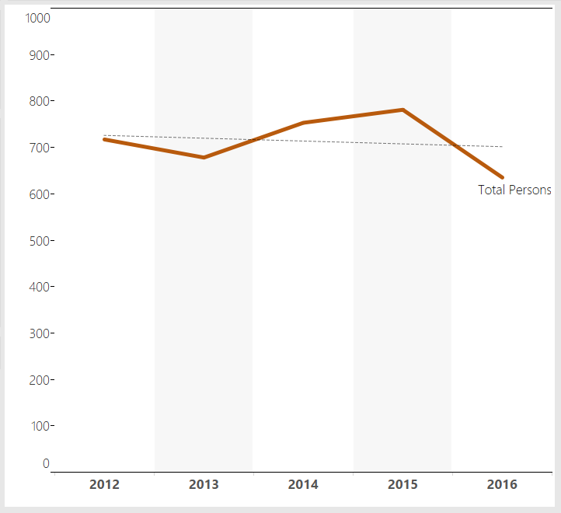
3 County CoC
2016
3 County CoC Data Report
Organization | All 3 County CoC Organizations and Programs
Topic | Point in Time Count Trends from 2012 to 2016
Description | The CoC was reconfigured in 2012 to include Berkshire County programs and exlude Hampden County programs. We now have 5 years of PIT Count data since the reconfiguration — enough to examine PIT Count trends and their underlying drivers.
3 County CoC Region ● Berkshire, Franklin, and Hampshire Counties
Point in Time Counts 2012 - 2016
Overall Point in Time Counts A downward trend is evident despite peaks and valleys. In 2012, there were 717 persons counted as homeless, while in 2016, 623 persons were counted, an overall reduction of 13%.

Slide 2
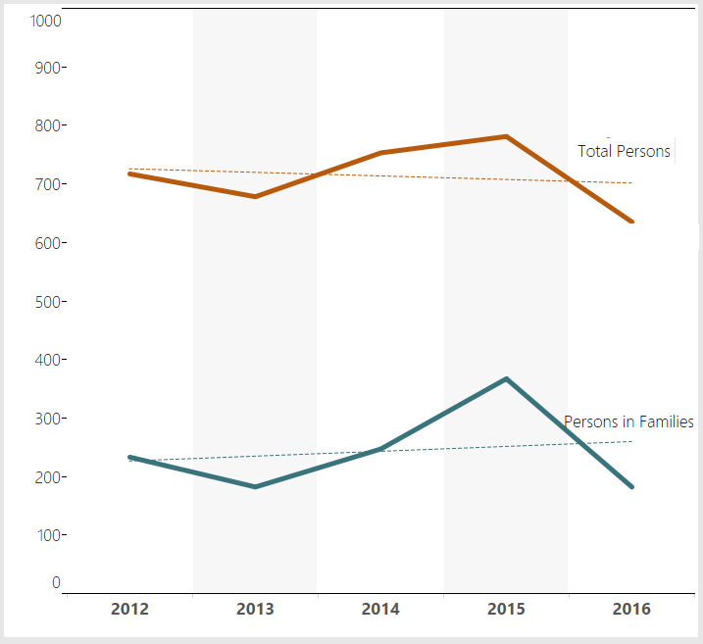
3 County CoC
2016
3 County CoC Region ● Berkshire, Franklin, and Hampshire Counties
Point in Time Counts 2012 - 2016
Persons in Families
Overall PIT trends are driven by the number of families in emergency shelter and overflow hotel/motel units.
A new family shelter model was implemented, reducing the number of families in hotel/motels.
Notes
In general, family shelter capacity stays constant, while hotel/motel utilization goes up or down based on demand.
Families in transitional housing comprise a small percentage of all families. In 2016, that percentage grew smaller, as one TH-FAM program stopped participating in the count because it no longer had dedicated beds for parents/ families with a history of homelessness. In 2012, there were 18 families in transitional housing. In 2016, there were only 3 families in transitional housing.

Slide 3
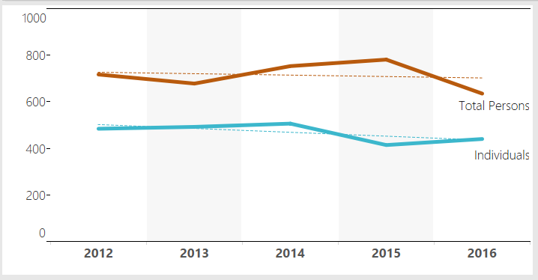
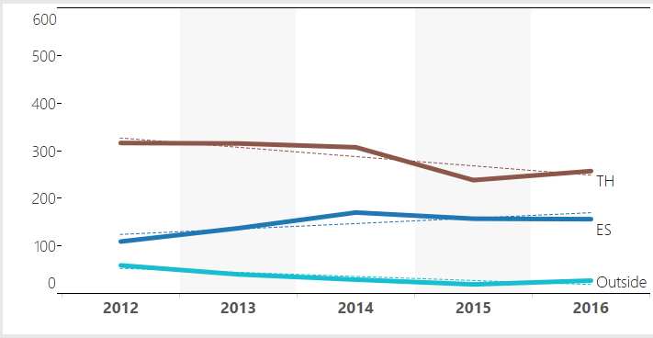
3 County CoC
2016
3 County CoC Region ● Berkshire, Franklin, and Hampshire Counties
Point in Time Counts 2012 - 2016
Individuals
Overall PIT trends are not driven by the number of homeless individuals...
...but individuals in TH drive the overall counts of homeless individuals.
Most CoC-funded TH beds were converted to PSH beds.
Notes
Although most CoC-funded TH-IND beds were converted to PSH beds by the 2015 PIT Count, the majority of TH beds were funded by Soldier On, Inc. rather than by the CoC. These beds were not converted and remained TH beds. On the night of the 2016 Count, 226 of 259 TH-occupied beds were Soldier On beds, representing 87% of TH-IND beds. (See next chart.)

Slide 4
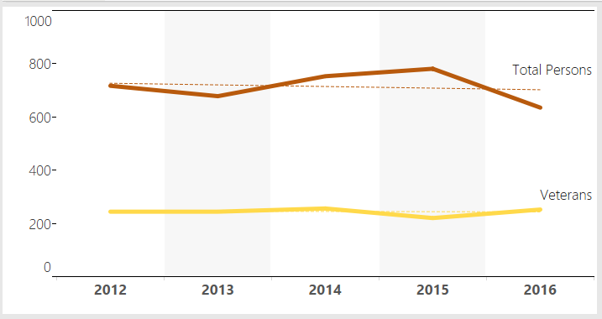
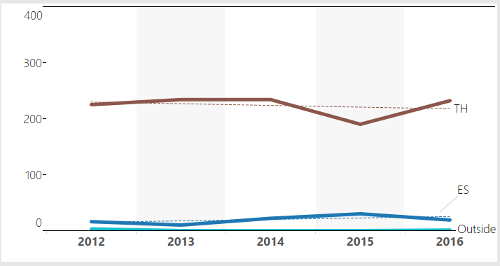
3 County CoC
2016
3 County CoC Region ● Berkshire, Franklin, and Hampshire Counties
Point in Time Counts 2012 - 2016
Veterans
The number of homeless veterans has stayed relatively constant...
...since the majority of homeless veterans are living in transitional housing.
2016 Veterans Count:
255 persons
Notes
Of all homeless veterans counted in 2016, 21 were staying in emergency shelter and 1 was staying outside. These persons represent 9% of all homeless veterans.
Of all veterans in emergency shelter, 1 person was a family head of household with children staying in family shelter. All other persons were individuals.

Slide 5
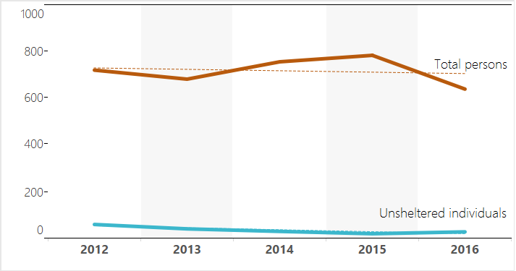
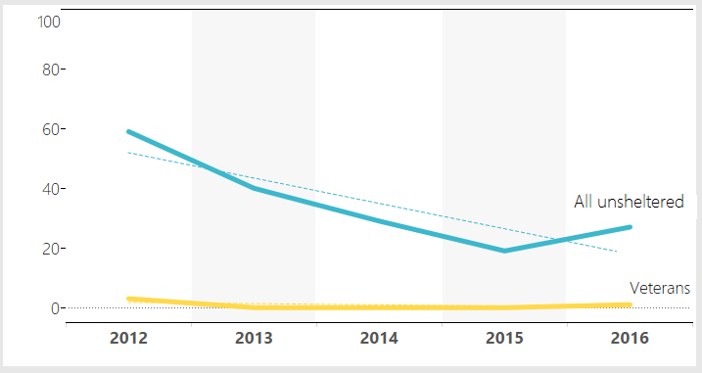
3 County CoC
2016
3 County CoC Region ● Berkshire, Franklin, and Hampshire Counties
Point in Time Counts 2012 - 2016
Unsheltered Persons
Unsheltered persons comprised 3.8% of all homeless persons in 2016.
No families were outdoors on the night of the count. It's rare that families in
Massachusetts are outdoors, due to family right-to-shelter laws.
A significant downward trend has resulted in a 54% reduction in the
unsheltered count over the past 5 years.
New winter shelter beds
Major snowstorm
...since the majority of homeless veterans are living in transitional housing.
Notes
Massachusetts has one of the lowest rates of unsheltered homelessness in the country. Last year it was 2.8%, compared to a national rate of 31%.
From 2012 to 2015, unsheltered counts went down by 25% across the country, and by 18% across the state. The CoCs significant drop has been due to the combination of new or expanded winter beds, along with newly dedicated permanent housing beds for chronically homeless individuals.

Slide 6
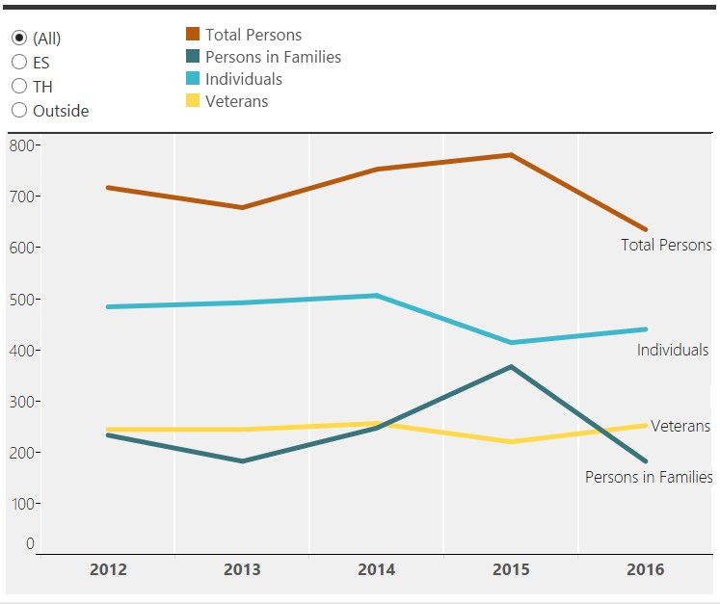
3 County CoC
2016
3 County CoC Region ● Berkshire, Franklin, and Hampshire Counties Point in Time Counts 2012 - 2016 Summary
A small downward trend has resulted in a 13% reduction in homelessness since 2012. The reduction has been driven by a reduction in family homelessness coupled with a smaller reduction in transitional housing capacity. These, in turn, are due to systems changes including the implementation of a new family shelter model and the conversion of transitional housing beds to permanent supportive housing beds. It's likely that SSVF rapid rehousing funds have also contributed to the downward trend.
Explore the data >>
Notes
It's possible, though not likely, that preliminary 2016 data may change slightly once the final PIT Count analysis is completed and confirmed. The final report will be issued in March or April.
The CoC has not yet received demographic information for persons staying in hotel/motels during the
2016 Count. Once this data is received, we will expand this report to include an analysis of homeless young adults/ unaccompanied youth; along with County-specific data.
For more information, contact Andrea Miller

Slide 7
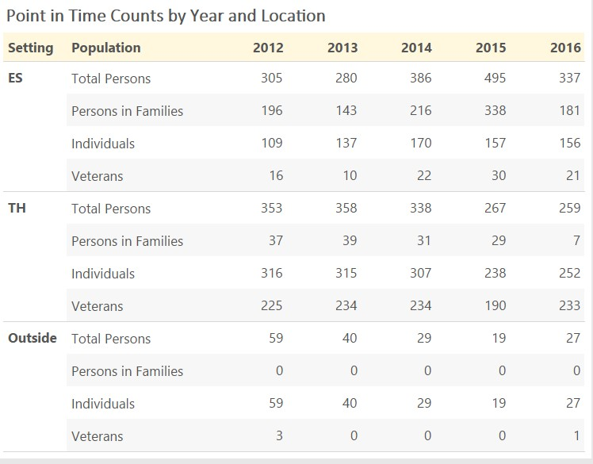
3 County CoC
2016
3 County CoC Region ● Berkshire, Franklin, and Hampshire Counties Point in Time Counts 2012 - 2016 Underlying Data
Explore the data >>
Notes
Summary of key events over the last 5 years
About 40 new winter shelter beds for individuals went online in November and December 2013, just prior to the 2014 PIT Count. There was a corresponding increase in the number of persons counted.
Most CoC-funded TH beds for individuals were converted to PSH during 2014, resulting in a lower TH- IND count in 2015.
One family TH program stopped offering dedicated homeless beds to families in September 2015 (due to contract requirements), resulting in a lower TH-FAM count in 2016.
There was a major snowstorm the night before the January 2015 PIT Count, which lasted into day, resulting in a significant decrease in the number of unsheltered persons counted during the 2015 PIT.
For more information, contact Andrea Miller

