Slide 1
EA and HomeBASE Summary July 2015 – May 2016
 | Number of Families
Families Applying | 8,216
Families Entering Shelters and Hotels/Motels | 3,956
HomeBASE Diversions | 1,287
Exits from Shelters and Hotels/Motels | 4,238
Exits with HomeBASE | 2,754
Total Caseload (May 31, 2016) | 3,847
Shelter Caseload | 3,343
Hotel/Motel Caseload | 504

Slide 2
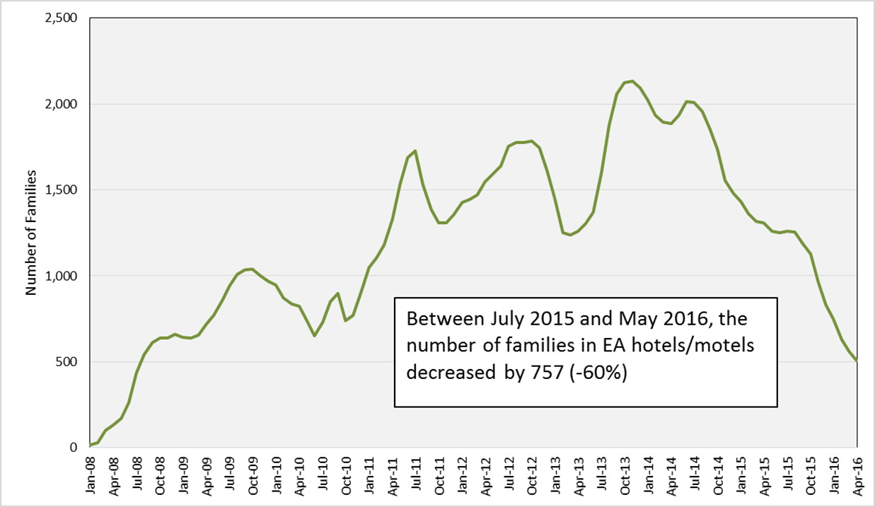
Monthly EA Hotel/Motel Caseload January 2008 – May 2016

Slide 3
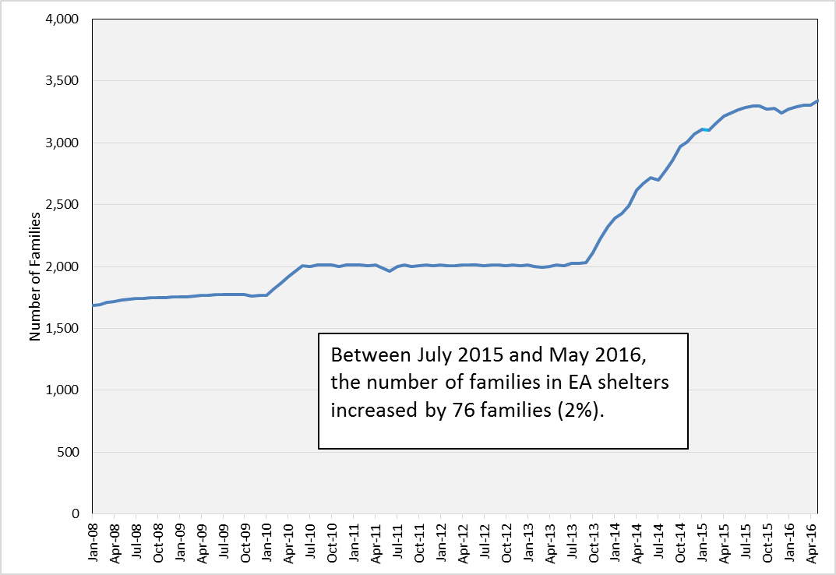
Monthly EA Shelter Caseload January 2008 – May 2016

Slide 4
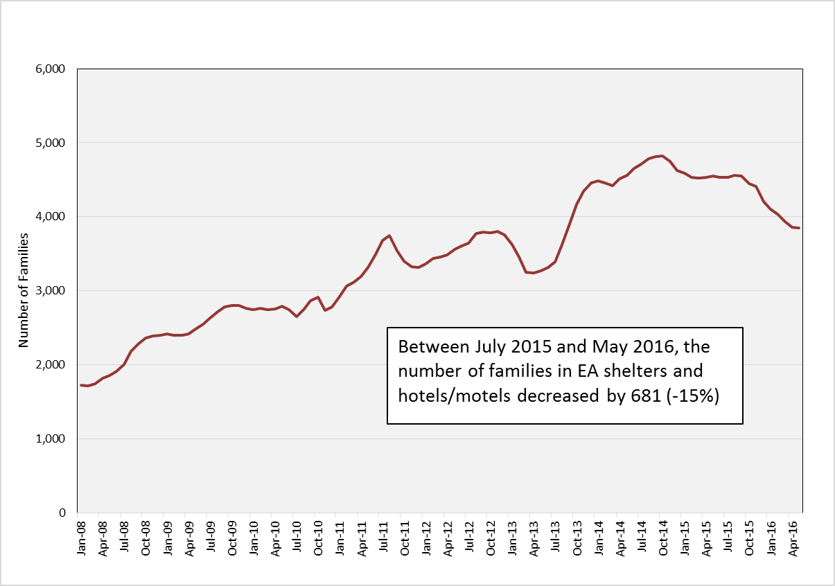
Total Monthly EA Shelter and Hotel/Motel Caseload January 2008 – May 2016

