Slide 1
Chronically Homeless
Presented by:
Erin Forbush
Katie Miernecki
Elizabeth Bienz
ServiceNet, Inc.
Janice Humason
Friends of the Homeless/Clinical & Support Options
Notes:
Who is audience? Where from/work? Why are they here?
Hold Questions—write down—time for questions at end

Slide 2
Overview of this workshop on Chronically Homeless
Who – is this subpopulation/HUD definition of chronic homeless
What – CoC and other resources to reduce and end chronic homelessness
When – “Real time” matching of prioritized chronic homeless to available housing (PSH)
Where – Western MA region CoCs
Why – Required /CoC Program Interim Rule
How – Coordinated Entry and how it works

Slide 3
HUD Definition of Chronic Homeless
The US Department of Housing and Urban Development (HUD) defines an INDIVIDUAL as chronically homeless if they have a:
Disability
Homeless living in a shelter, safe haven, or place not meant for human habitation for
  12 continuous months or
  Four separate occasions in the last three years (must total 12 months).
Breaks in homelessness, while the individual is residing in an institutional care facility will not count as a break in homelessness.
Additionally, an individual who is currently residing in an institutional care facility for less than 90 days and meets the above criteria for chronic homelessness may also be considered chronically homeless.
Lastly, a FAMILY with an adult/minor head of household who meets the above mentioned criteria may also be considered chronically homeless, despite changes in family composition (unless the chronically homeless head of household leaves the family).

Slide 4
Chronic Homelessness
Disability can include one or more of the following:
  Substance Use Disorder,
  Serious Mental Illness,
  Developmental Disability,
  Posttraumatic Stress Disorder,
  Cognitive Impairments Resulting From Brain Injury,
  Chronic Physical Illness

Slide 5
Chronic Verification
Documentation required for verifying disability:
Written verification from a licensed professional to diagnose and treat the disability and certification that the disability is expected to be long-continuing or of indefinite duration and substantially impedes the individual’s ability to live independently
Written verification from SSA
The receipt of a disability check

Slide 6
Chronic Verification
Documentation required for verifying homelessness:
Documentation from HMIS/Comparable database
Written observation by outreach worker or referral by another housing or service provider
Documentation from institutions such as hospitals, correctional facilities, etc.
Self certification (3 months of the 12 month verification)

Slide 7
Homeless in our communities in western MA

Slide 8
Where are Chronic Homeless Served in Western MA Region
Continuum of Care (CoC) for Western MA
Three County CoC
  Berkshire County
  Franklin County
  Hampshire County
Springfield-Hampden County CoC

Slide 9
Data on Chronic Homeless in our Region
Use of Annual Point in Time (PIT) Count
  Unduplicated count of persons experiencing homelessness
  Required by HUD for all communities receiving federal CoC funds
  Sheltered and unsheltered count on one night

Slide 10
2018 PIT Count by CoC
3 County CoC
  72 chronically homeless individuals
  0 chronically homeless families
  651 homeless persons
    404 Individuals/247 Families
Springfield-Hampden County CoC
  59 chronically homeless individuals
  39 chronically homeless families (157 people)
  2,321 homeless persons (includes 1,047 disaster placements from PR)

Slide 11
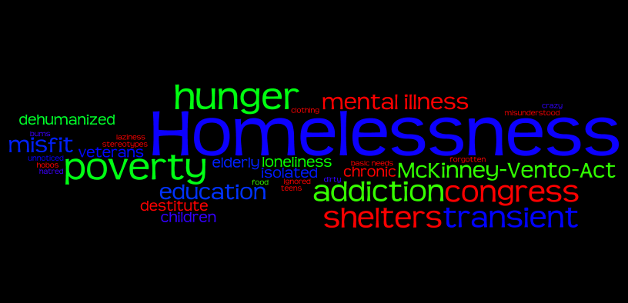
Why Prioritize
Chronic Homeless?
Notes:
Who are the chronically homeless—living in the street, mental health, addiction, medical issues, CORI, DV, etc.—generational poverty

Slide 12
Why Prioritize
Chronic Homeless?
The CoC Program Interim Rule requires all CoCs to establish a Coordinated Entry System to prioritize those most in need of housing assistance
Many CoCs prioritize chronically homeless for permanent supportive housing (PSH)
Notes:
Who are the chronically homeless—living in the street, mental health, addiction, medical issues, CORI, DV, etc.—generational poverty

Slide 13

Reducing and Ending
Chronic Homelessness
How?
Coordinated Entry System

Slide 14
What is Coordinated Entry
Transformative
Client centered
Housing focused
Data driven
Efficient
Effective
Evolving
Notes:
Transformative – in that it changes a system to prioritize those with the greatest needs to housing that best meets those needs

Slide 15
Difference in Focus Before and After Coordinated Entry Implementation
Before Coordinated Entry Implementation
After Coordinated Entry Implementation
Should we accept this person into our project?
Project-centric
Different forms and assessment for each organization or small subgroup of projects
Project-specific decision-making
Ad hoc referral process between projects
Uneven knowledge about available housing and service interventions in the CoC’s geographic area
What housing and service assistance strategy among all available is best for this household?
Person-centric
Standard forms and assessment used by every project for every participant
Community agreement on how to triage based on the household’s needs
Coordinated referral process across the CoC’s geographic area based on written standards for administering CoC assistance
Notes:
Transformative – in that it changes a system to prioritize those with the greatest needs to housing that best meets those needs

Slide 16
What is Coordinated Entry
In HUD’s vision, the coordinated entry process is an approach to coordination and management of a crisis response system’s resources that allows users to make consistent decisions from available information to efficiently and effectively connect people to interventions that will rapidly end their homelessness.

Slide 17
How Coordinated Entry Works
Core Elements
Access - identify access points
Assessment – standardized assessment tool and process
Prioritization – managing prioritized lists such as By Name Lists (BNL)
By Name Lists & Data
Referral - to appropriate housing and supportive services
Management & Leadership

Slide 18
Coordinated Entry Access
Determine access points in CoC
  Street Outreach – outreach workers and community stakeholders
  Resource Center/Drop-in Centers
  Emergency Shelters
  Hotlines

Slide 19
Coordinated Entry Assessment
Utilize standardized assessment tool and consent form
  Valid
  Reliable
  Inclusive
  Person-centered
  User friendly
  Strengths based
  Housing first orientation
  Sensitive to lived experience
  Transparent

Slide 20
Coordinated Entry Prioritization
Case Conference Meetings to review by name list (BNL), assign navigators and discuss various aspects of client housing plans
Service Provider and community stakeholders
  Shelter Providers
  Housing Providers
  Hospitals
  Behavioral Health Providers
  Alcohol and Drug Treatment Providers
  Department of Mental Health
  Department of Developmental Disabilities
  Churches
  Any and all interested parties

Slide 21
By Name Lists & Data
Data
  A real time registry of everyone experiencing homelessness that can then create a by name list (BNL) of those who are chronic
    Inflow – outreach, drop ins, resource center, emergency shelters
    Outflow – navigators, housing providers
By Name List (BNL)
  Able to produce a real time BNL of chronic homeless which prioritizes the area’s most vulnerable based on prioritization criteria such as assessment scores

Slide 22
Coordinated Entry Referral
Housing referrals
  Prioritized individuals are matched to vacancies based on prioritized criteria
Various types of housing and assistance
  Permanent supportive housing (PSH)
  Rapid Rehousing (RRH)
  Quickly match vacancy with individual or household from the BNL
    Example: individuals who are chronic are referred to permanent supportive housing (PSH) based on level of need and length of homelessness.

Slide 23
Management & Leadership
Leadership
CoC Administrator
    Funding
    Planning and Development
Provider network
  Coordinated Entry P&P
Management
  Case management/Housing navigation
  Case Conference meetings and follow up
  Goals to reduce and end chronic homelessness

Slide 24
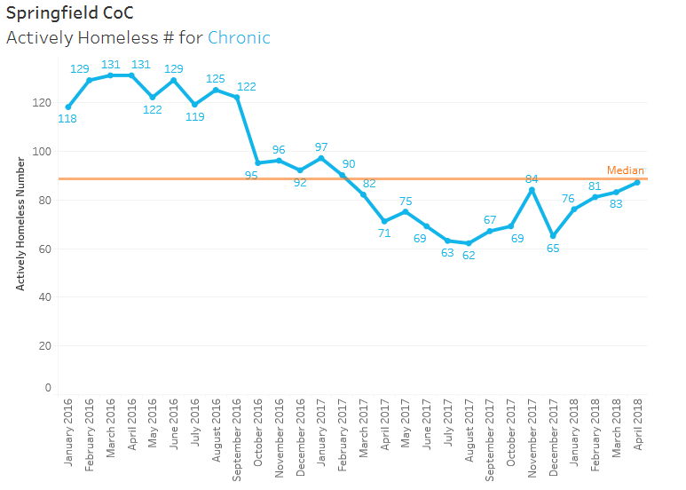
Results:
Reducing Chronically Homeless

Slide 25

Chronic Homelessness
Contacts:
Erin Forbush at eforbush@servicenet.org
413.448.5358 x119
Katie Miernecki at kmiernecki@servicenet.org
413.585.1398
Elizabeth Bienz at ebienz@servicenet.org
413.772.6100 x206
Janice Humason at jhumason@csoinc.org
413.732.3069
Notes:
Have business cards available

Slide 26

Chronic Homelessness
Thank you for your attention!
Questions?
Comments?

Slide 27
Chronic Homelessness
Coordinated Entry/CoC
3 County Continuum of Care (CoC)
  Berkshire, Franklin, and Hampshire
  Funding U.S. Dept. of Housing and Urban Development (HUD)
  Hotline: 1-888-413-WMAS (9627)
Weekly Meetings in each County
  Pittsfield—Wednesdays 2pm, 141 North Street
  Greenfield—Tuesdays 1pm, 60 Wells Street
  Northampton—Mondays 1pm, 43 Center Street
Currently there are 85 CH on the list since February 2018.

Slide 28
Notes:
Refer to handout and talk about documentation and additional handout. You may be asked for documentation

