Slide 1

Opioid Crisis and Homelessness
Holle Garvey, NP
Geraldine Kennedy, NP
Mollie Sullivan, LMHC
Mercy Medical Center
Health Care for the Homeless Program
Contributions From:
Katie Krauskopf, MD, MPH
Mercy Behavioral Health Care
Outpatient Addiction Services

Slide 2
No one was born with, or grew up aspiring,
to have an addiction.
No one.

Slide 3
THE FIX | DIRECTED BY LAURA NAYLOR |
FESTIVAL TRAILER
https://vimeo.com/91038989

Slide 4
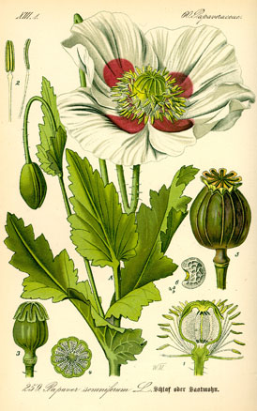
Overview
Definition of Addiction
Addiction is a Chronic Disease
Understanding Recovery
Treatment Strategies
Medication Assisted Treatment
Harm Reduction
Homelessness and Addiction
Resources

Slide 5

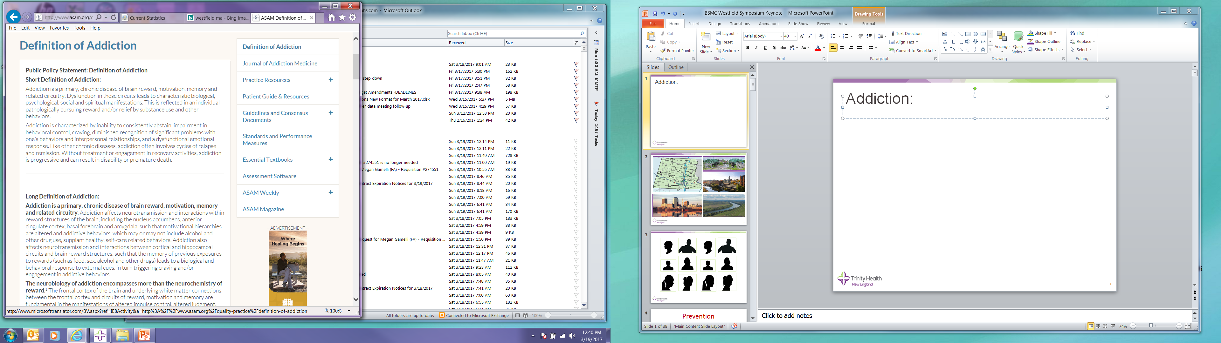

Slide 6
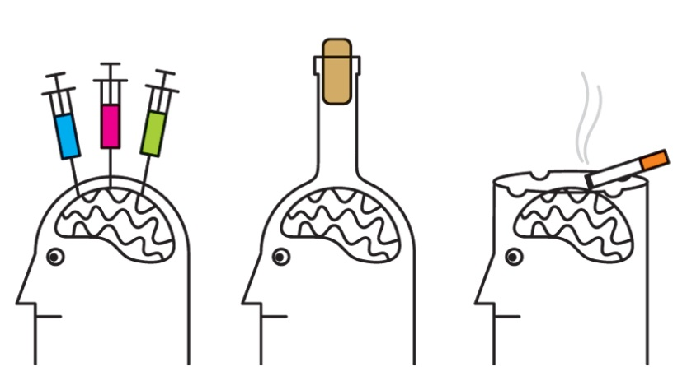
Addiction is a primary,
chronic disease of brain reward, motivation, memory and related circuitry:
●Compulsive Behavior ●Loss of Control
●Consequences ●Craving

Slide 7

Chronic Disease
→ Cannot be prevented by vaccines
→ Persistent or otherwise long-lasting in its effects
→ Results in fundamental changes in pathophysiology of one or more organ system
→ Can be controlled with, but not completely cured by medication
www.asam.org/resources/definition-of-addiction; Bernell. Front Public Health. 2016; chronicdata.cdc.gov;

Slide 8

Chronic Disease
→ Does not simply disappear
→ Cycles of relapse and remission
→ Without treatment or engagement in recovery:
Impact becomes progressive
Can result in disability or premature death
www.asam.org/resources/definition-of-addiction; Bernell. Front Public Health. 2016

Slide 9
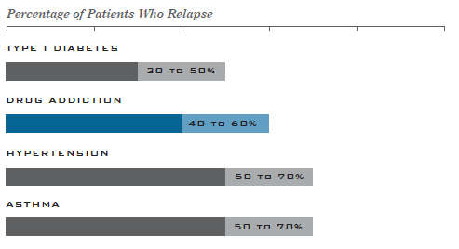
Relapse: Addiction vs Other Diseases
McLellan. JAMA. 2000; www.drugabuse.gov/publications/principles-drug-addiction-treatment-research-based-guide-third-edition
Notes:
Genetic and environmental contributions
Treatment may involve behaviors, lifestyle choices
Drug addiction shares many features with other chronic illnesses, including a tendency to run in families (heritability), an onset and course that is influenced by environmental conditions and behavior, and the ability to respond to appropriate treatment, which may include long-term lifestyle modification.¹
Characterized by a loss of control
Compare drug addiction to diabetes
McLellan AT, Lewis DC, O’Brien CP, and Kleber HD. Drug dependence, a chronic medical illness: Implications for treatment, insurance, and outcomes evaluation. JAMA 284(13):1689-1695, 2000.

Slide 10

Language Matters
Substance Use Disorder
Person with SUD
Person in Recovery
Negative (or positive) toxicology test
Substance Abuse
Addict, Alcoholic, Abuser
Clean
Clean, Dirty

Slide 11
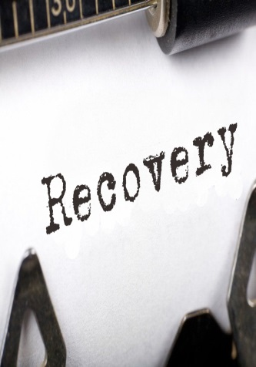
Individual Recovery
Stable state of health, self-management
Access and maintain a stable, safe place to live
Engage in meaningful daily activities
Attain independence, participate in society
    Foster relationships of support, love, hope
Notes:
Reduce violence and injury: interpersonal violence, motor vehicle crashes, homicides
Decrease transmission of infectious diseases (HIV and hepatitis C)
For example, the average cost for 1 full year of methadone maintenance treatment is approximately $4,700 per patient, whereas 1 full year of imprisonment costs approximately $24,000 per person
According to several conservative estimates, every dollar invested in addiction treatment programs yields a return of between $4 and $7 in reduced drug-related crime, criminal justice costs, and theft.

Slide 12

Public Health, Societal Recovery
Improve worker productivity
Reduce criminal justice costs
Reduce violence and injury
Decrease transmission of infectious diseases
Facing Addiction in America: The Surgeon General's Report on Alcohol, Drugs, and Health. SAMHSA, Office of the Surgeon General. 2016; Tsui. JAMA Internal Medicine. 2014; Metzger. Journal of Acquired Immune Deficiency Syndromes. 1993
Notes:
Reduce violence and injury: interpersonal violence, motor vehicle crashes, homicides
Decrease transmission of infectious diseases (HIV and hepatitis C)
For example, the average cost for 1 full year of methadone maintenance treatment is approximately $4,700 per patient, whereas 1 full year of imprisonment costs approximately $24,000 per person
According to several conservative estimates, every dollar invested in addiction treatment programs yields a return of between $4 and $7 in reduced drug-related crime, criminal justice costs, and theft.

Slide 13
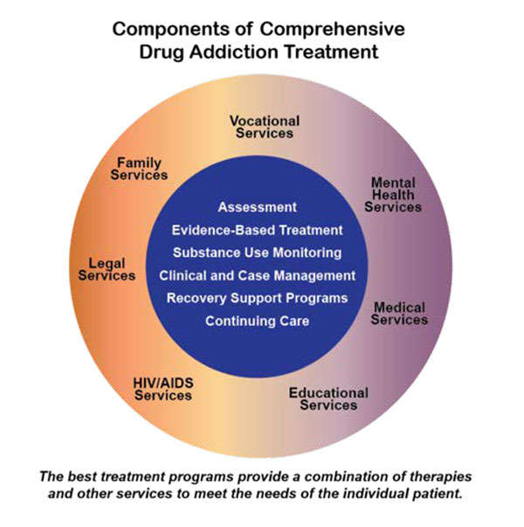
SAMHSA. National Survey of Substance Abuse Treatment Services (N-SSATS): 2013. Data on Substance Abuse Treatment Facilities. 2014.
Notes:
Medications, behavioral therapies, medical services, social services
Because drug abuse and addiction have so many dimensions and disrupt so many aspects of an individual’s life, treatment is not simple. Effective treatment programs typically incorporate many components, each directed to a particular aspect of the illness and its consequences. Addiction treatment must help the individual stop using drugs, maintain a drug-free lifestyle, and achieve productive functioning in the family, at work, and in society.e for all chronic diseases

Slide 14
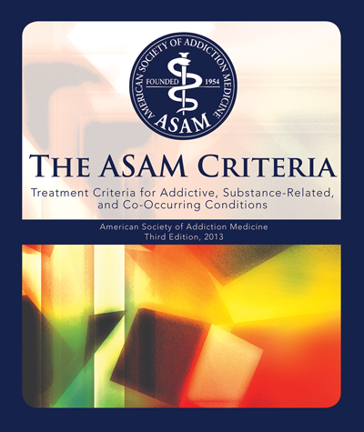
Notes:
ASAM’s Criteria are the most intensively studied set of addiction placement criteria. Scientists began
the crucial process of testing ASAM’s criteria in the early 1990s to develop decision rules not simply
through expert consensus, but through an international system of data gathering, quantitative
analysis, and empirical feedback. Dozens of reports published in the peer-reviewed literature have
been supported by over $7 million of US government funding. Project funding came from the
National Institute on Drug Abuse and the National Institute on Alcohol Abuse and Alcoholism, and
the Center for Substance Abuse Treatment of the Substance Abuse and Mental Health Services
Administration. A considerable body of work exists to date on the ASAM Criteria including at least
ten evaluations involving a total of 3,672 subjects. Several controlled studies have found that
treatment based on the ASAM Criteria is associated with less morbidity, better client functioning,
and more efficient service utilization than mismatched treatment. These results support the
predictive validity and cost-effectiveness of the use of ASAM Criteria. They also indicate that the
ASAM Criteria have valid clinical decision-making guidelines, good feasibility and reliability through a
standardized computer assessment instrument, and good concurrent validity.

Slide 15
ASAM Criteria: Goals
Foster treatment plans that:
  Use a multidimensional patient assessment
  Match assessment findings with specific levels of treatment
  Allow for coordinated transitions across levels of care, reflecting patient needs
www.asam.org/resources/the-asam-criteria/about; www.asam.org/docs/default-source/publications/standards-of-care-final-design-document.pdf

Slide 16

Addiction Treatment
Pharmacological Treatments
(Medications)
Behavioral Therapies
Medical Services
Social Services
Notes:
Why do people take drugs in the first place? TO FEEL GOOD or TO FEEL LESS BAD/EMPTY/VOID

Slide 17

Principles of Effective Treatment
Addiction is a complex, treatable chronic disease affecting brain function and behavior
Effective treatment not one-size fits all
Treatment should be readily available and attend to multiple needs of the individual

Slide 18
Principles of Effective Treatment
Adequate time in treatment
is critical
Treatment plans should be reassessed and modified to meet changing recovery needs
www.drugabuse.gov/publications/principles-drug-addiction-treatment-research-based-guide-third-edition/principles-effective-treatment

Slide 19
Principles of Effective Treatment
Medical detoxification is the first stage of addiction treatment – by itself does not usually change long-term drug abuse
Medications are an important long-term treatment tool for many, especially combined with counseling, behavioral therapies
www.drugabuse.gov/publications/principles-drug-addiction-treatment-research-based-guide-third-edition/principles-effective-treatment

Slide 20
Treatment
Treaatment Saves Lives

Slide 21
Definition
Multi-modal addiction treatment approach:
Psychosocial Therapy
+
FDA-approved Medication
to address cravings, withdrawal symptoms
www.asam.org/docs/default-source/practice-support/guidelines-and-consensus-docs/asam-national-practice-guideline-supplement; www.cdc.gov/drugoverdose/pdf/ hhs_prescription_drug_abuse_report_09.2013

Slide 22
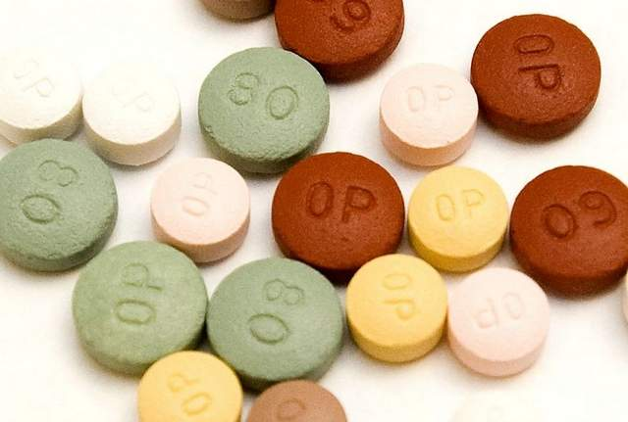
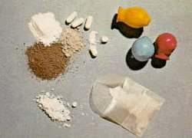
Treatment
IMPROVED MENTAL HEALTH
MORE JOBS
HEALTHIER FAMILIES
LESS CRIME
LESS VIOLENCE
IMPROVED HEALTH
MORE STABLE HOUSING
MAT Saves Lives
Notes:
AND INNUMERABLE LIVES SAVED

Slide 23
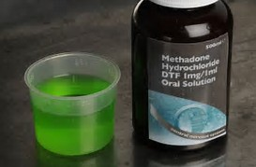
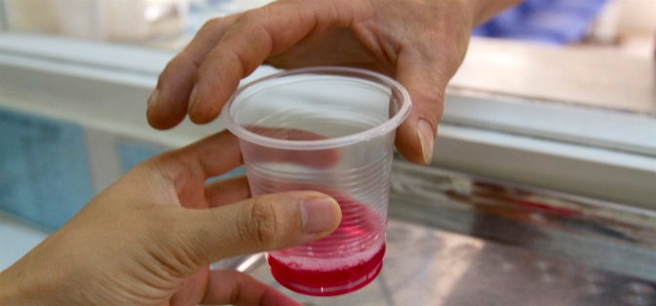
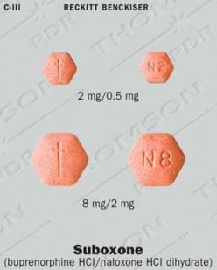
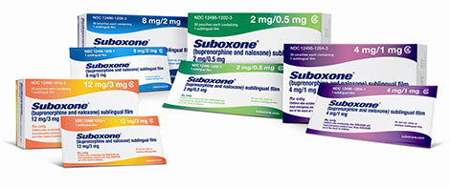
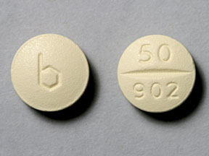
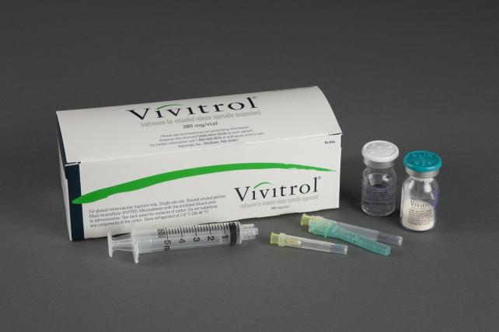
Medications for Opioid Use
Methadone
Buprenorphine
Suboxone, subutex, bunavail
Naltrexone
Vivitrol, Revia
Notes:
In fact, in 2009, the World Health Organization Guidelines recommended methadone and buprenorphine as first line agents for agonist maintenance treatment

Slide 24
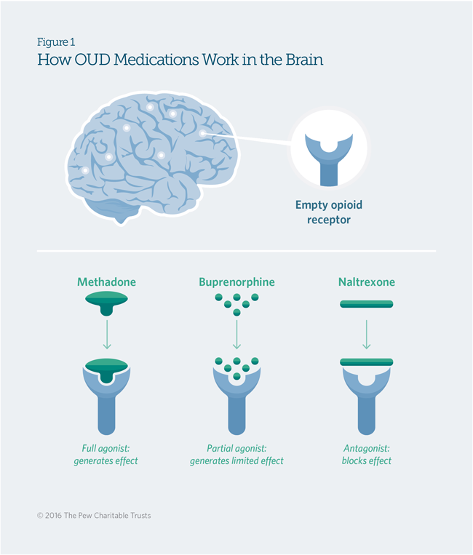
MAINTAINS TOLERANCE
NO TOLERANCE

Slide 25
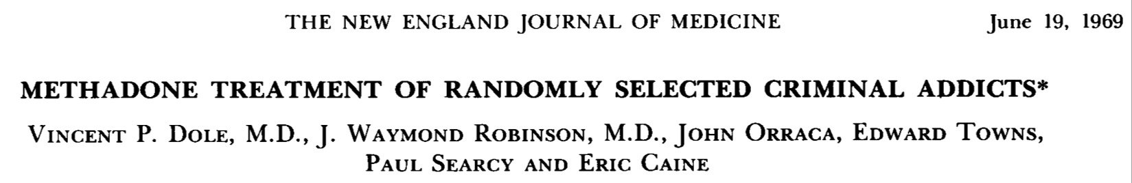
Treatment for OUD: Methadone
Reduces mortality (death rates), including from overdose
Reduces illicit drug use, including non-opiates
Increases abstinence rates
Improves retention in treatment
Reduces criminality and legal problems
Allows for return to productive activities: family, work, etc.
50 years of evidence!

Slide 26
Treatment for OUD: Buprenorphine
Can be prescribed out of office or opioid treatment program setting by qualified licensed prescribers.
Buprenorphine now comes in variety of formulations (tablet, film, injectable, implantable) and is equally effective as moderate doses of methadone (e.g. 60-80 mg per day)
Clinical trails have demonstrated benefit of buprenorphine in regards to:
    Reduction in illicit use
    Increased retention in treatment
    Allows for return to productive activities
Notes:
26

Slide 27
Treatment for OUD: Naltrexone
Has no intrinsic potential for misuse or addiction
Available as tablet or depot injection; less impact on treatment in US thus far due to poor patient adherence.
      Medication is less intrinsically reinforcing
      Medication is not necessarily associated with other structured treatment (but perhaps should be)
      Relatively high dropout rates
Overall may not be as effective in treating opioid cravings as methadone or buprenorphine

Slide 28
Harm Reduction Spectrum
Harm
Reduction
A means to provide substance users with a safe environment in which to use,
in the name of reducing the amount of harm associated with using that drug.
The focus is on preventing harm before preventing use of drugs or alcohol.
Chaotic
Use
Abstinence
Harm Reduction assumes those who are actively using substances can make positive changes in their lives regardless of their current relationship with substances.

Slide 29
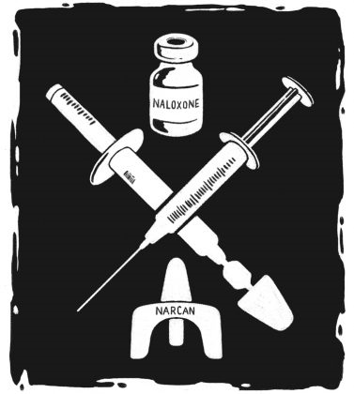
Harm Reduction Strategies
Don’t use alone and don’t use together
Have Narcan available at all times
Using fewer drugs, or using them less often and/or less dangerous drugs
Syringe access programs
Test shots or slow shots
Using Fentanyl test strips to test your
drug

Slide 30

Harm Reduction Strategies
Medication assisted recovery programs
Treatment vs jail sentences
Access to clean supplies
Education on safe injecting practices
Condom distribution
Peer recovery support centers
Don’t delay in calling 911
(Good Samaritan Laws)
Safe injection sites

Slide 31
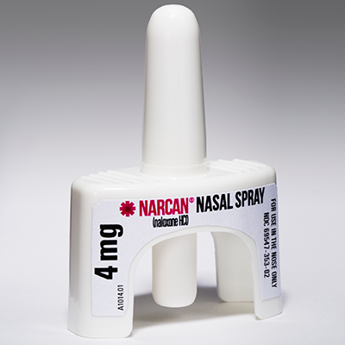
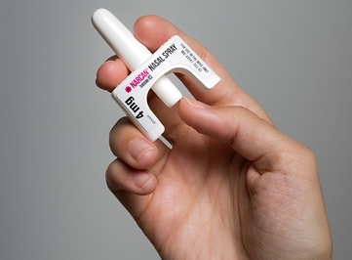
Narcan
~Naloxone ~ Narcan
~Reverses Opiate overdoses
~Is safe and easy to use
~Is easily obtained at Walgreens, CVS
or Mercy RX without a prescription
Call 911 when overdose suspected
Give 2 rescue breaths
Administer Narcan into nose
4. Continue rescue breathing

Slide 32
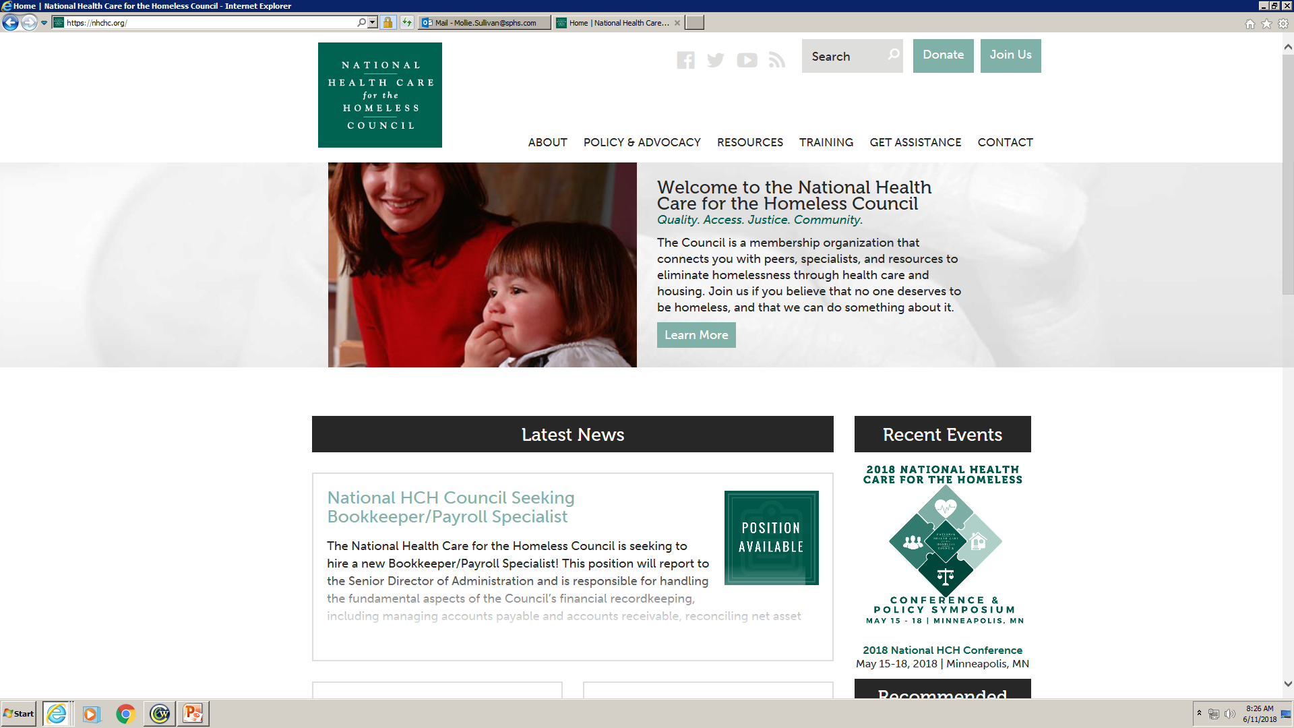
National Health Care for the Homeless Council www.nhchc.org

Slide 33
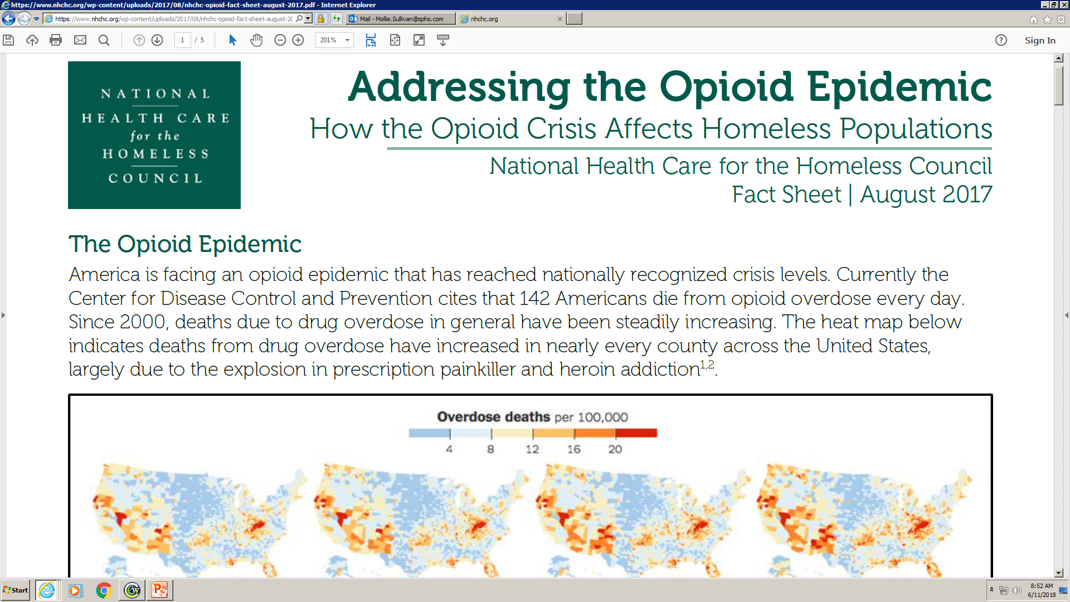

Slide 34

Homelessness and Opioid Use
According to a 2016 policy brief released by the National Health Care for the Homeless Council on medication assisted treatment, persons experiencing homelessness have even higher rates of substance use disorders, poorer health, and higher mortality rates by opioid overdose than national averages.
Housing is a major social determinant of health, and lack of housing has been shown to negatively impact physical and behavioral health among individuals experiencing homelessness. Addiction can cause and prolong homelessness and the experience of homelessness complicates one’s ability to engage in TX.

Slide 35
Homelessness and Opioid Use
Comorbidity factors: The association of mental illness with substance-related disorders is well established. In a national sample, 75% of patients experiencing homelessness with a past-year substance use disorder also had a comorbid non-substance related mental illness. In addition to SUD and serious mental illness, many people experiencing homelessness have acute and chronic physical health problems and histories of trauma.
According to the Substance Abuse and Mental Health Services Administration SAMHSA, 20 to 25% of the homeless population in the United States suffers from some form of severe mental illness. In comparison, only 6% of Americans are severely mentally ill.
Compared to 61% nationally, 81% of overdose deaths were caused by opioids among those experiencing homelessness.

Slide 36
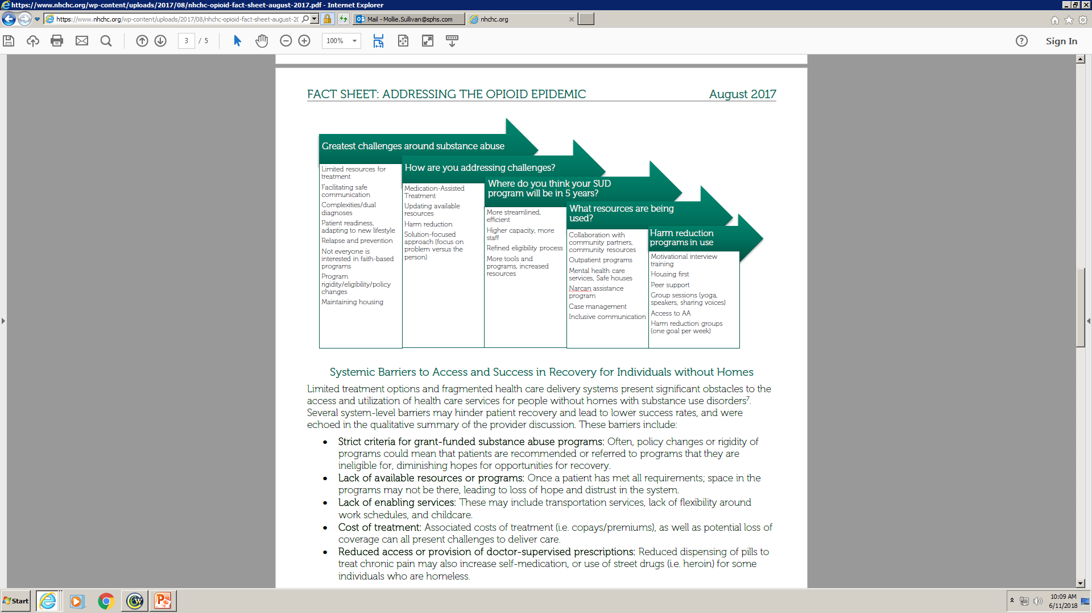

Slide 37
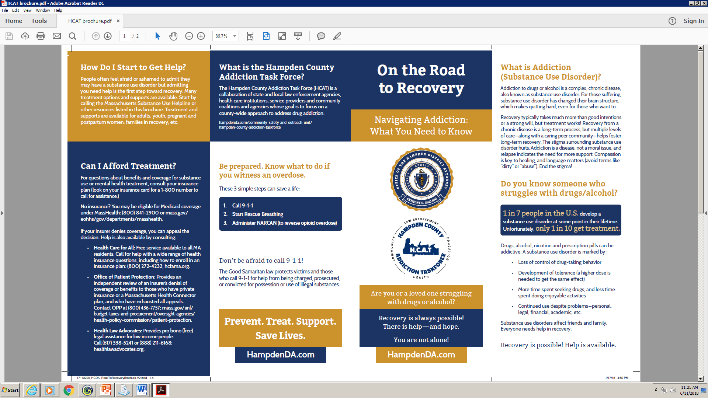
Resources

Slide 38
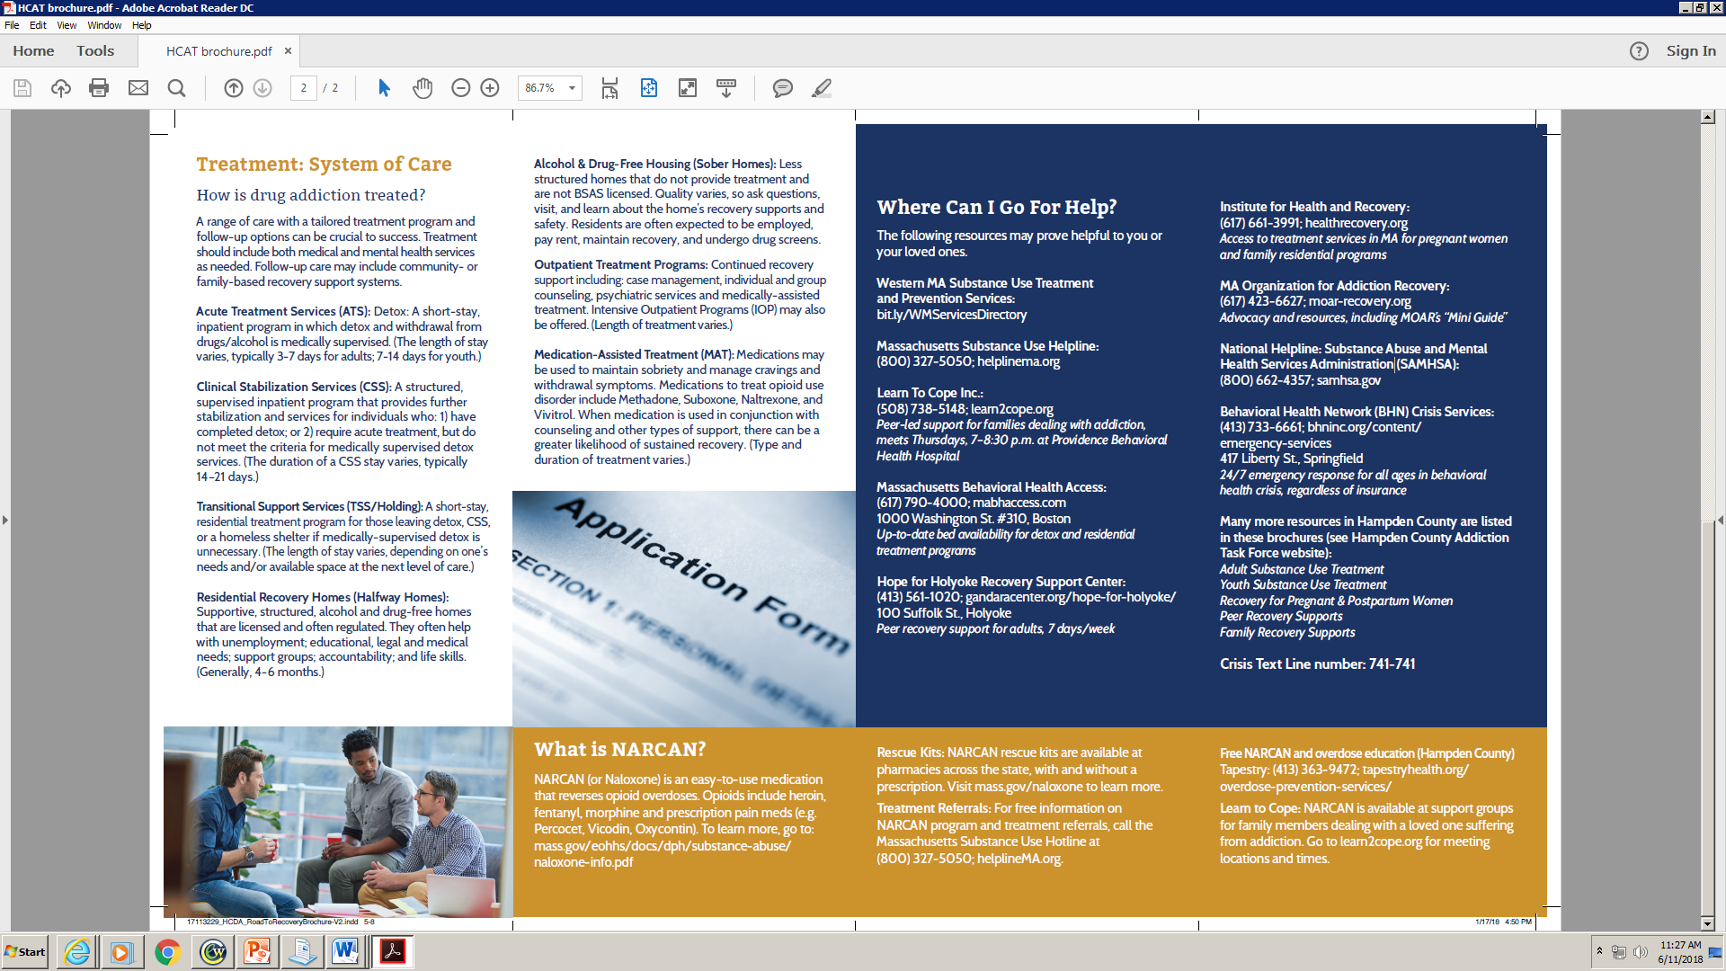
Resources

Slide 39


Resources
Alison Proctor, MA
Program Director, Opioid Overdose Prevention Substance Use Disorder Prevention Services
Springfield Dept. of Health and Human Services Phone: (413) 750-2695
aproctor@springfieldcityhall.com

Slide 40
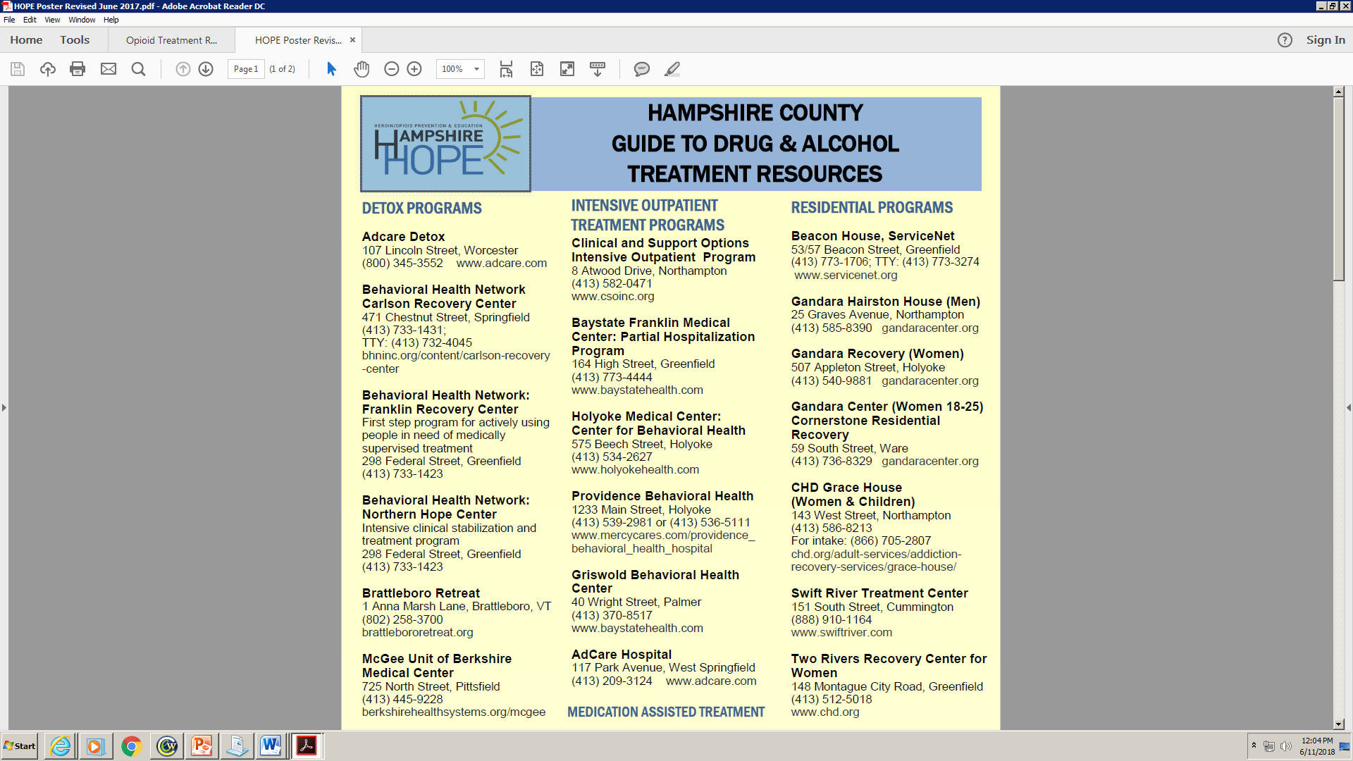

Slide 41
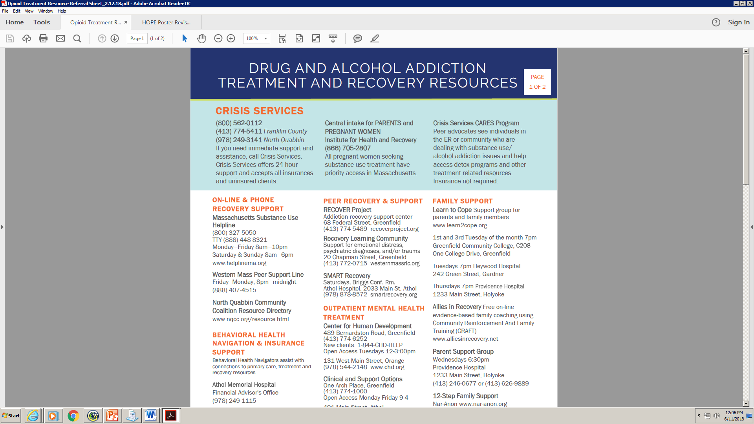

Slide 42
FOCUS ON PREVENTION
(EARLIER & MORE EFFECTIVE)
EXPAND & ENHANCE TREATMENT
(THAT WORKS, WITH MEDICATIONS)
SUPPORT PEOPLE IN RECOVERY
(LONG-TERM HOUSING, EMPLOYMENT)
FIGHT STIGMA
(ADDICTION IS A DISEASE, NOT A CHOICE)

Slide 43


Slide 44
Thank You!
Holle Garvey, NP
Holle.Garvey@sphs.com
Geraldine Kennedy, NP
Geraldine.Kennedy@sphs.com
Mollie Sullivan, LMHC
Mollie.Sullivan@sphs.com

